Slide 1

Doub less Living!
The Gospel of
LUKE
That you may have certainty!

Slide 2


#igyhtbt

Slide 3
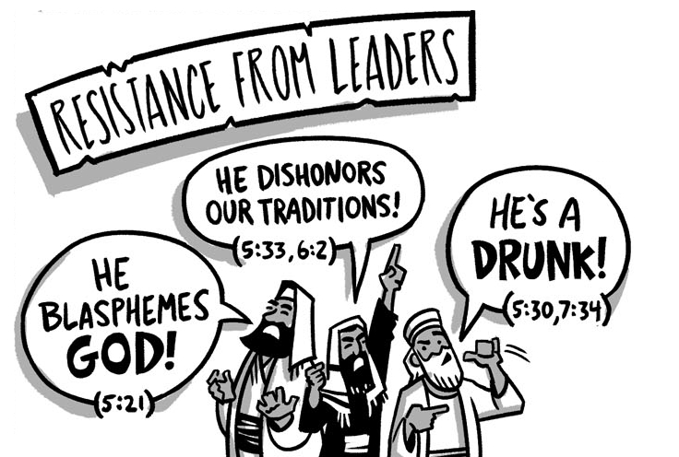

The Rise of Opposition
Five Controversies
Part Four
Luke 6:6-11
Luke 6:12-16

Slide 4
The Rise of Opposition 5 Controversies
❺
❹
Healing
Luke 6:6-11
❸
Picking Grain
Luke 6:1-5
❷
Fasting
Luke 5:33-39
❶
Associating with Sinners
Luke 5:27-32
Forgiving
Sins
Luke 5:27-32
Sabbath

Slide 5
Controversy Over Healing Luke 6:6-11 (CSB)
⁶ On another Sabbath he entered the synagogue and was teaching. A man was there whose right hand was shriveled. ⁷ The scribes and Pharisees were watching him closely, to see if he would heal on the Sabbath, so that they could find a charge against him. ⁸ But he knew their thoughts and told the man with the shriveled hand, "Get up and stand here." So he got up and stood there. ⁹ Then Jesus said to them, "I ask you: Is it lawful to do good on the Sabbath or to do evil, to save life or to destroy it?" ¹⁰ After looking around at them all, he told him, "Stretch out your hand." He did, and his hand was restored. ¹¹ They, however, were filled with rage and started discussing with one another what they might do to Jesus.

Slide 6

Controversy Over Healing Luke 6:6-11 (CSB)
⁷ The scribes and Pharisees were watching him closely, to see if he would heal on the Sabbath, so that they could find a charge against him. ⁸ But he knew their thoughts…
What were the scribes and Pharisees doing when this passage opens?

Slide 7
Controversy Over Healing Luke 6:6-11 (CSB)
⁷ The scribes and Pharisees were watching him closely, to see if he would heal on the Sabbath, so that they could find a charge against him. ⁸ But he knew their thoughts…
The Greek word (pareterounto) is very emotive;
it means to spy on or watch out of the corner
of one’s eye, which adds a sinister note.
What were the Pharisees looking
for specifically?

Slide 8
Controversy Over Healing Luke 6:6-11 (CSB)
⁷ The scribes and Pharisees were watching him closely, to see if he would heal on the Sabbath, so that they could find a charge against him. ⁸ But he knew their thoughts…
In general, healing or medical work was not done on the Sabbath, unless a life was in danger, a baby was being born, or circumcision was needed.
So, was the
man’s life in danger?
Pharisaical Perspective
The Pharisees’ had their ideal “gotcha” moment with Jesus.

Slide 9
Controversy Over Healing Luke 6:6-11 (CSB)
⁷ The scribes and Pharisees were watching him closely, to see if he would heal on the Sabbath, so that they could find a charge against him. ⁸ But he knew their thoughts…
Jesus Is Not Naive
He knows they are trying to trap Him; but He doesn’t back away. The Pharisees may be secretive; but Jesus is open.

Slide 10

Controversy Over Healing Luke 6:6-11 (CSB)
⁹ Then Jesus said to them, "I ask you: Is it lawful to do good on the Sabbath or to do evil, to save life or to destroy it?" ¹⁰ After looking around at them all, he told him, "Stretch out your hand." He did, and his hand was restored.
How did Jesus respond to the Pharisees’ challenge?

Slide 11
Controversy Over Healing Luke 6:6-11 (CSB)
⁹ Then Jesus said to them, "I ask you: Is it lawful to do good on the Sabbath or to do evil, to save life or to destroy it?" ¹⁰ After looking around at them all, he told him, "Stretch out your hand." He did, and his hand was restored.
How did Jesus respond to the Pharisees’ challenge?
What question did Jesus ask them?

Slide 12
Controversy Over Healing Luke 6:6-11 (CSB)
⁹ Then Jesus said to them, "I ask you: Is it lawful to do good on the Sabbath or to do evil, to save life or to destroy it?" ¹⁰ After looking around at them all, he told him, "Stretch out your hand." He did, and his hand was restored.
Law of the Sabbath
“The intent of the Sabbath was to prevent people from working several consecutive days without rest, to provide time for rejuvenation, and to give time to contemplate God. Certainly it was never intended to prevent one from doing good.” (Darrell Bock, BECNT)

Slide 13


Controversy Over Healing Luke 6:6-11 (CSB)
⁹ Then Jesus said to them, "I ask you: Is it lawful to do good on the Sabbath or to do evil, to save life or to destroy it?" ¹⁰ After looking around at them all, he told him, "Stretch out your hand." He did, and his hand was restored.
Jesus’ question puts the Pharisees in a dilemma.
Jesus doesn’t wait for their answer, He turns to demonstrate God’s endorsement for doing good on the Sabbath.

Slide 14


Controversy Over Healing Luke 6:6-11 (CSB)
⁹ Then Jesus said to them, "I ask you: Is it lawful to do good on the Sabbath or to do evil, to save life or to destroy it?" ¹⁰ After looking around at them all, he told him, "Stretch out your hand." He did, and his hand was restored.
What does Jesus do when the Pharisees don’t respond?
The endorsement comes with the healing, since God doesn’t respond in such situations to a sinner.
The miracle serves as an audiovisual pointing to the truth about doing good on the Sabbath and validating Jesus’ point.

Slide 15
Controversy Over Healing Luke 6:6-11 (CSB)
¹¹ They, however, were filled with rage and started discussing with one another what they might do to Jesus.
How did the Pharisees respond to the healing?

Slide 16
Controversy Over Healing Luke 6:6-11 (CSB)
¹¹ They, however, were filled with rage and started discussing with one another what they might do to Jesus.
Mindless rage or irrational anger in the Greek.
How did the Pharisees respond to the healing?

Slide 17
Controversy Over Healing Luke 6:6-11 (CSB)
¹¹ They, however, were filled with rage and started discussing with one another what they might do to Jesus.
Why were the Pharisees so enraged?
Jesus performed no "work" on the Sabbath—He simply spoke a few words and a hand was completely restored.
He humiliated the religious leaders and healed the man all at the same time without even breaking the Pharisees' law.

Slide 18
Controversy Over Healing Luke 6:6-11 (CSB)
¹¹ They, however, were filled with rage and started discussing with one another what they might do to Jesus.
How did the Pharisees respond to being humiliated by Jesus?

Slide 19
Controversy Over Healing Luke 6:6-11 (CSB)
¹¹ They, however, were filled with rage and started discussing with one another what they might do to Jesus.
How did the Pharisees respond to being humiliated by Jesus?
This is one area where Luke understates the magnitude of the response.
Mark 3:6 – “Immediately the Pharisees went out and started plotting with the Herodians against him, how they might kill him.”
Matthew 12:14 - ”But the Pharisees went out and plotted against him, how they might kill him.”

Slide 20
Jesus’ Response Luke 6:12-16 (CSB)
¹² During those days he went out to the mountain to pray and spent all night in prayer to God. ¹³ When daylight came, he summoned his disciples, and he chose twelve of them, whom he also named apostles: ¹⁴ Simon, whom he also named Peter, and Andrew his brother; James and John; Philip and Bartholomew; 15 Matthew and Thomas; James the son of Alphaeus, and Simon called the Zealot; 16 Judas the son of James, and Judas Iscariot, who became a traitor.
How did Jesus respond to the encounter?

Slide 21
Jesus’ Response Luke 6:12-16 (CSB)
¹² During those days he went out to the mountain to pray and spent all night in prayer to God. ¹³ When daylight came, he summoned his disciples, and he chose twelve of them, whom he also named apostles: ¹⁴ Simon, whom he also named Peter, and Andrew his brother; James and John; Philip and Bartholomew; 15 Matthew and Thomas; James the son of Alphaeus, and Simon called the Zealot; 16 Judas the son of James, and Judas Iscariot, who became a traitor.
How did Jesus respond to the encounter?

Slide 22
Jesus’ Response Luke 6:12-16 (CSB)
¹² During those days he went out to the mountain to pray and spent all night in prayer to God. ¹³ When daylight came, he summoned his disciples, and he chose twelve of them, whom he also named apostles: ¹⁴ Simon, whom he also named Peter, and Andrew his brother; James and John; Philip and Bartholomew; 15 Matthew and Thomas; James the son of Alphaeus, and Simon called the Zealot; 16 Judas the son of James, and Judas Iscariot, who became a traitor.
What did Jesus do the next morning?

Slide 23
Jesus’ Response Luke 6:12-16 (CSB)
¹² During those days he went out to the mountain to pray and spent all night in prayer to God. ¹³ When daylight came, he summoned his disciples, and he chose twelve of them, whom he also named apostles: ¹⁴ Simon, whom he also named Peter, and Andrew his brother; James and John; Philip and Bartholomew; 15 Matthew and Thomas; James the son of Alphaeus, and Simon called the Zealot; 16 Judas the son of James, and Judas Iscariot, who became a traitor.
What did Jesus do the next morning?
In my opinion, the die had been cast and Jesus knew it was time to bring others into the process of spreading the Good News.
Why did Jesus calls the Apostles?

Slide 24


Deliberate Discipleship
People are watching you, just like they did Jesus. Are they drawn to Him or driven away from Him by what they see in your life?
Jesus spent all night in prayer before choosing the Apostles, what kinds of decisions or events are pending in your life that require extended prayer time?
Jesus chose the Apostles to be special messengers of the Gospel, but He commissioned all believers to be disciple makers. How are you doing?

Slide 25
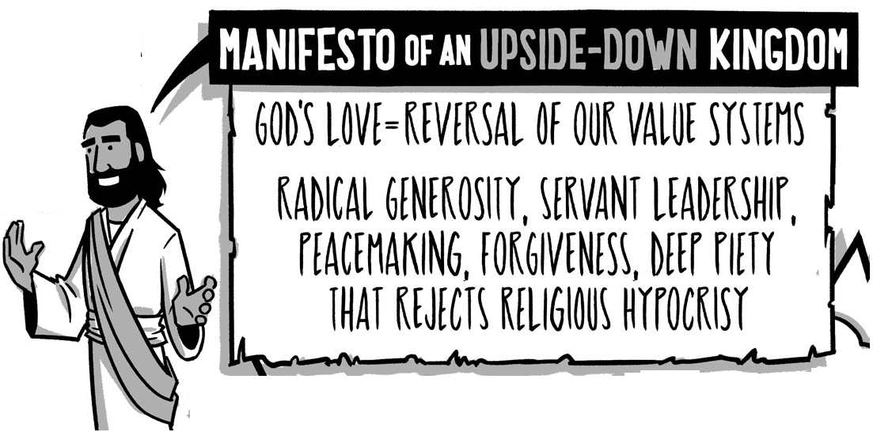
The
Beatitudes
Luke 6:17-23

